Slide 1







Optimal Join Algorithms meet Top-𝑘
SIGMOD 2020 tutorial
Nikolaos Tziavelis, Wolfgang Gatterbauer, Mirek Riedewald
Northeastern University, Boston
Ranked results
Part 1 : Top-$k$
Time
Slides: https://northeastern-datalab.github.io/topk-join-tutorial/
DOI: https://doi.org/10.1145/3318464.3383132
Data Lab: https://db.khoury.northeastern.edu
This work is licensed under a Creative Commons Attribution-Noncommercial-Share Alike 4.0 International License. See https://creativecommons.org/licenses/by-nc-sa/4.0/ for details

Slide 2


Recommended Zoom interaction (also posted in Slack)
Q&A: Please use the Q&A for research questions. One of two not presenting will answer in the box.
Chat: Please use the chat only for technical problems.
Post-tutorial Zoom space: In case we cannot answer your question by text and during the tutorial (we only have 1.5h), we are happy to continue discussing after the tutorial in a separate Zoom space: https://northeastern.zoom.us/j/92753337349
Slack: We love feedback. If you have questions / comments / concerns after the tutorial today, please contact us in Slack. We are also happy to meet again later if there is interest.

Slide 3

Why "Optimal Join Algorithms meet Top-𝑘"?
Optimal Join algorithms
Top-𝑘
Return all results over joins
Given 𝑘, return 𝑘 “best” results
⇒ How to avoid large intermediate results?
⇒ How to avoid working on any lower ranked results?
Ranked Enumeration (Any-𝑘)
Incrementally return the 𝑘 “best” results over joins (for any 𝑘 = 1, 2, ...)
⇒ How to most effectively push sorting through joins?

Slide 4
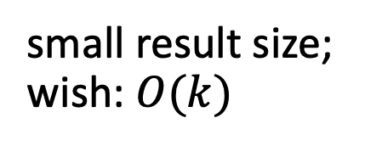
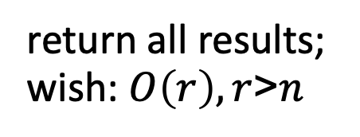
Top-𝑘
Optimal Join Algorithms
Any-𝑘
middleware cost model
(# accesses)
RAM cost model
return all results;
wish: $O\left(r\right), r$>$n$
ranking function
conjunctive queries
small result size; wish: $O(k)$
query decompositions
most important results first
all results are equally important
minimize intermediate results
return only 𝑘-best results
incremental computation

Slide 6





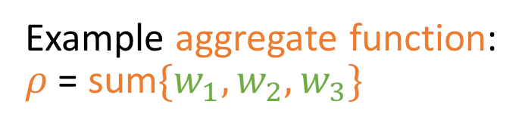



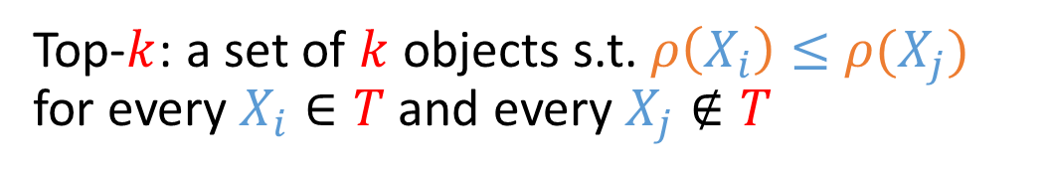

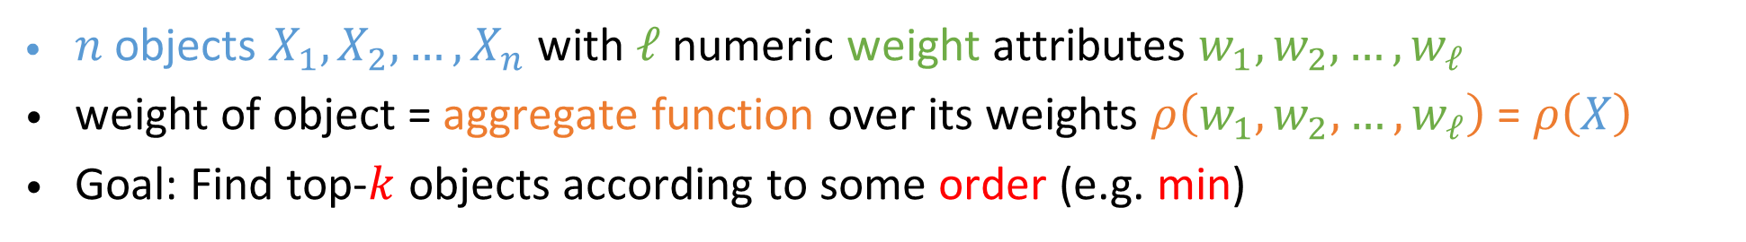


Top-$k$ Selection Query: overall setup
$n$ objects $X_{1},X_{2},…, X_{n}$ with $ℓ$ numeric weight attributes $w_{1},w_{2},…, w_{ℓ}$
weight of object = aggregate function over its weights $ρ\left(w_{1},w_{2},…, w_{ℓ}\right)$ = $ρ\left(X\right)$
Goal: Find top-$k$ objects according to some order (e.g. min)
In most original papers assumed to be max!
id
$${ w}_{1}$$
$${ w}_{2}$$
$${ w}_{3}$$
sum
Example aggregate function: $ρ$ = sum$\{w_{1},w_{2}, w_{3}\}$
$$X_{1}$$
3
4
3
10
$$X_{2}$$
4
2
4
10
$$X_{3}$$
6
8
1
15
$$X_{4}$$
7
6
6
18
Top-$k$: a set of $k$ objects s.t. $ρ\left(X_{i}\right)≤$ $ρ(X_{j})$
for every $X_{i}∈T$and every $X_{j}∉T$
$$X_{5}$$
8
7
5
20
$$n=5 ,ℓ=3$$
$$,k=2$$

Slide 7





















Top-$k$ Selection Query: information in different relations
Weights are stored in $ℓ$ distinct relations $R_{i}$
$$R_{1}$$
$$R_{2}$$
$$R_{3}$$
id
$${ w}_{1}$$
$${ w}_{2}$$
$${ w}_{3}$$
sum
id
$${ w}_{1}$$
id
$${ w}_{2}$$
id
$${ w}_{3}$$
$$X_{1}$$
3
4
3
10
$$X_{1}$$
3
$$X_{1}$$
4
$$X_{1}$$
3
$$X_{2}$$
4
2
4
10
$$X_{2}$$
4
$$X_{2}$$
2
$$X_{2}$$
4
$$X_{3}$$
6
8
1
15
$$X_{3}$$
6
$$X_{3}$$
8
$$X_{3}$$
1
$$X_{4}$$
7
6
6
18
$$X_{4}$$
7
$$X_{4}$$
6
$$X_{4}$$
6
$$X_{5}$$
8
7
5
20
$$X_{5}$$
8
$$X_{5}$$
7
$$X_{5}$$
5

Slide 8





























Top-$k$ Selection Query: sorted access
Weights are stored in $ℓ$ distinct relations $R_{i}$
each $R_{i}$ is sorted by attribute $w_{i}$
$$R_{1}$$
$$R_{2}$$
$$R_{3}$$
id
$${ w}_{1}$$
$${ w}_{2}$$
$${ w}_{3}$$
sum
id
$${ w}_{1}$$
id
$${ w}_{2}$$
id
$${ w}_{3}$$
$$X_{1}$$
3
4
3
10
$$X_{1}$$
3
$$X_{1}$$
4
$$X_{1}$$
3
$$X_{2}$$
4
2
4
10
$$X_{2}$$
4
$$X_{2}$$
2
$$X_{2}$$
4
$$X_{3}$$
6
8
1
15
$$X_{3}$$
6
$$X_{3}$$
8
$$X_{3}$$
1
$$X_{4}$$
7
6
6
18
$$X_{4}$$
7
$$X_{4}$$
6
$$X_{4}$$
6
$$X_{5}$$
8
7
5
20
$$X_{5}$$
8
$$X_{5}$$
7
$$X_{5}$$
5

Slide 9









Top-$k$ Selection Query: sorted access
Weights are stored in $ℓ$ distinct relations $R_{i}$
each $R_{i}$ is sorted by attribute $w_{i}$
$$R_{1}$$
$$R_{2}$$
$$R_{3}$$
id
$${ w}_{1}$$
$${ w}_{2}$$
$${ w}_{3}$$
sum
id
$${ w}_{1}$$
id
$${ w}_{2}$$
id
$${ w}_{3}$$
Notice we sort in increasing order
$$X_{1}$$
3
4
3
10
$$X_{1}$$
3
$$X_{2}$$
2
$$X_{3}$$
1
$$X_{2}$$
4
2
4
10
$$X_{2}$$
4
$$X_{1}$$
4
$$X_{1}$$
3
$$X_{3}$$
6
8
1
15
$$X_{3}$$
6
$$X_{4}$$
6
$$X_{2}$$
4
$$X_{4}$$
7
6
6
18
$$X_{4}$$
7
$$X_{5}$$
7
$$X_{5}$$
5
$$X_{5}$$
8
7
5
20
$$X_{5}$$
8
$$X_{3}$$
8
$$X_{4}$$
6

Slide 10

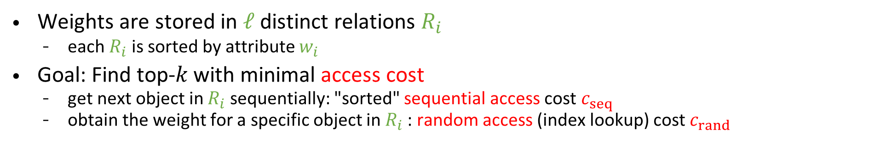










Top-$k$ Selection Query: "middleware" assumption
Assumption 1: Middleware cost model: we aggregate rankings of other services.
we only pay for accesses to attribute lists
2 types of access: sequential / random
Weights are stored in $ℓ$ distinct relations $R_{i}$
each $R_{i}$ is sorted by attribute $w_{i}$
Goal: Find top-𝑘 with minimal access cost
get next object in $R_{i}$ sequentially: "sorted" sequential access cost $c_{seq}$
obtain the weight for a specific object in $R_{i}$: random access (index lookup) cost $c_{rand}$
$$R_{1}$$
$$R_{2}$$
$$R_{3}$$
id
$${ w}_{1}$$
$${ w}_{2}$$
$${ w}_{3}$$
sum
id
$${ w}_{1}$$
id
$${ w}_{2}$$
id
$${ w}_{3}$$
Notice we sort in increasing order
$$X_{1}$$
3
4
3
10
$$X_{1}$$
3
$$X_{2}$$
2
$$X_{3}$$
1
$$X_{2}$$
4
2
4
10
$$X_{2}$$
4
$$X_{1}$$
4
$$X_{1}$$
3
$$X_{3}$$
6
8
1
15
$$X_{3}$$
6
$$X_{4}$$
6
$$X_{2}$$
4
$$X_{4}$$
7
6
6
18
$$X_{4}$$
7
$$X_{5}$$
7
$$X_{5}$$
5
$$X_{5}$$
8
7
5
20
$$X_{5}$$
8
$$X_{3}$$
8
$$X_{4}$$
6

Slide 11

Top-$k$ Selection Query as a Join Problem
Assumption 1: Middleware cost model: we aggregate rankings of other services.
we only pay for accesses to attribute lists
2 types of access: sequential / random
Weights are stored in $ℓ$ distinct relations $R_{i}$
each $R_{i}$ is sorted by attribute $w_{i}$
Goal: Find top-𝑘 with minimal access cost
get next object in $R_{i}$ sequentially: "sorted" sequential access cost $c_{seq}$
obtain the weight for a specific object in $R_{i}$: random access (index lookup) cost $c_{rand}$
$$R_{1}$$
$$R_{2}$$
$$R_{3}$$
id
$${ w}_{1}$$
$${ w}_{2}$$
$${ w}_{3}$$
sum
id
$${ w}_{1}$$
id
$${ w}_{2}$$
id
$${ w}_{3}$$
select R₁.id,
sum(w₁,w₂,w₃) as weight
from R₁, R₂, R₃
where R₁.id=R₂.id
and R₂.id=R₃.id
order by weight
limit 2
$$X_{1}$$
3
4
3
10
$$X_{1}$$
3
$$X_{2}$$
2
$$X_{3}$$
1
$$X_{2}$$
4
2
4
10
$$X_{2}$$
4
$$X_{1}$$
4
$$X_{1}$$
3
$$X_{3}$$
6
8
1
15
$$X_{3}$$
6
$$X_{4}$$
6
$$X_{2}$$
4
$$X_{4}$$
7
6
6
18
$$X_{4}$$
7
$$X_{5}$$
7
$$X_{5}$$
5
$$X_{5}$$
8
7
5
20
$$X_{5}$$
8
$$X_{3}$$
8
$$X_{4}$$
6
~ Joins on unique object id: 1–1 relationships

Slide 12
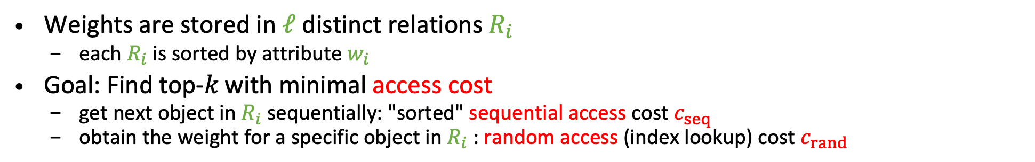

Naive algorithm: retrieve all items
Assumption 1: Middleware cost model: we aggregate rankings of other services.
we only pay for accesses to attribute lists
2 types of access: sequential / random
Weights are stored in $ℓ$ distinct relations $R_{i}$
each $R_{i}$ is sorted by attribute $w_{i}$
Goal: Find top-𝑘 with minimal access cost
get next object in $R_{i}$ sequentially: "sorted" sequential access cost $c_{seq}$
obtain the weight for a specific object in $R_{i}$: random access (index lookup) cost $c_{rand}$
$$R_{1}$$
$$R_{2}$$
$$R_{3}$$
id
$${ w}_{1}$$
$${ w}_{2}$$
$${ w}_{3}$$
sum
id
$${ w}_{1}$$
id
$${ w}_{2}$$
id
$${ w}_{3}$$
select R₁.id,
sum(w₁,w₂,w₃) as weight
from R₁, R₂, R₃
where R₁.id=R₂.id
and R₂.id=R₃.id
order by weight
limit 2
$$X_{1}$$
3
4
3
10
$$X_{1}$$
3
$$X_{2}$$
2
$$X_{3}$$
1
$$X_{2}$$
4
2
4
10
$$X_{2}$$
4
$$X_{1}$$
4
$$X_{1}$$
3
$$X_{3}$$
6
8
1
15
$$X_{3}$$
6
$$X_{4}$$
6
$$X_{2}$$
4
$$X_{4}$$
7
6
6
18
$$X_{4}$$
7
$$X_{5}$$
7
$$X_{5}$$
5
$$X_{5}$$
8
7
5
20
$$X_{5}$$
8
$$X_{3}$$
8
$$X_{4}$$
6
Naive algorithm: retrieve all items, sort, return top-𝑘
Cost = ${n⋅ℓ⋅c}_{sort}$

Slide 13

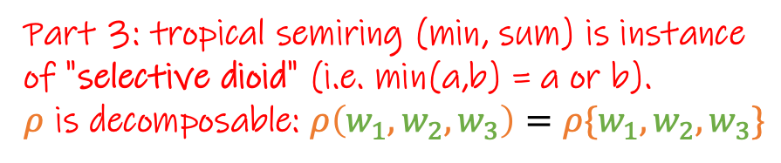
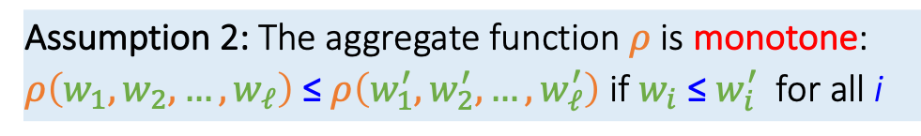
Assumption 2: monotonicity of $ρ$
Assumption 1: Middleware cost model: we aggregate rankings of other services.
we only pay for accesses to attribute lists
2 types of access: sequential / random
Weights are stored in $ℓ$ distinct relations $R_{i}$
each $R_{i}$ is sorted by attribute $w_{i}$
Goal: Find top-𝑘 with minimal access cost
get next object in $R_{i}$ sequentially: "sorted" sequential access cost $c_{seq}$
obtain the weight for a specific object in $R_{i}$: random access (index lookup) cost $c_{rand}$
$$R_{1}$$
$$R_{2}$$
$$R_{3}$$
id
$${ w}_{1}$$
$${ w}_{2}$$
$${ w}_{3}$$
sum
id
$${ w}_{1}$$
id
$${ w}_{2}$$
id
$${ w}_{3}$$
select R₁.id,
sum(w₁,w₂,w₃) as weight
from R₁, R₂, R₃
where R₁.id=R₂.id
and R₂.id=R₃.id
order by weight
limit 2
$$X_{1}$$
3
4
3
10
$$X_{1}$$
3
$$X_{2}$$
2
$$X_{3}$$
1
$$X_{2}$$
4
2
4
10
$$X_{2}$$
4
$$X_{1}$$
4
$$X_{1}$$
3
$$X_{3}$$
6
8
1
15
$$X_{3}$$
6
$$X_{4}$$
6
$$X_{2}$$
4
$$X_{4}$$
7
6
6
18
$$X_{4}$$
7
$$X_{5}$$
7
$$X_{5}$$
5
$$X_{5}$$
8
7
5
20
$$X_{5}$$
8
$$X_{3}$$
8
$$X_{4}$$
6
Assumption 2: The aggregate function $ρ$ is monotone:
$ρ\left(w_{1},w_{2},…, w_{ℓ}\right)$ ≤ $ρ\left(w_{1}^{′},w_{2}^{′},…,w_{ℓ}^{′}\right)$ if $w_{i}$ ≤ ${w_{i}^{′}}_{ }$ for all i
Part 3: tropical semiring (min, sum) is instance of "selective dioid" (i.e. min(a,b) = a or b). $ρ$ is decomposable: $ρ\left(w_{1},w_{2}, w_{3}\right)=ρ\{w_{1},w_{2}, w_{3}\}$

Slide 14
Important early work making these assumptions
Fagin’s algorithm:
Fagin. Combining fuzzy information from multiple systems. PODS 1996. https://doi.org/10.1145/237661.237715
Fagin. Fuzzy queries in multimedia database systems. PODS 1998. https://doi.org/10.1145/275487.275488
Fagin. Combining fuzzy information from multiple systems. JCSS 1999. https://doi.org/10.1006/jcss.1998.1600
Threshold Algorithm (TA):
Nepal, Ramakrishna. Query processing issues in image (multimedia) databases. ICDE 1999. https://doi.org/10.1109/ICDE.1999.754894
Güntzer, Balke, Kießling. Optimizing multifeature queries for image databases. VLDB 2000. https://dl.acm.org/doi/10.5555/645926.671875
Fagin, Lotem, Naor. Optimal aggregation algorithms for middleware. JCSS 2003. https://doi.org/10.1016/S0022-0000(03)00026-6
2014 Gödel Prize on "a framework to design and analyze algorithms where aggregation of information from multiple data sources is needed... introduced the notion of instance optimality"

Slide 16



Threshold algorithm [Fagin+ 03]
Access next objects in all $R_{i}$ sequentially
$$R_{1}$$
$$R_{2}$$
$$R_{3}$$
id
$${ w}_{1}$$
id
$${ w}_{2}$$
id
$${ w}_{3}$$
$$X_{1}$$
3
$$X_{2}$$
2
$$X_{3}$$
1
$$X_{2}$$
4
$$X_{1}$$
4
$$X_{1}$$
3
$$X_{3}$$
6
$$X_{4}$$
6
$$X_{2}$$
4
$$X_{4}$$
7
$$X_{5}$$
7
$$X_{5}$$
5
$$X_{5}$$
8
$$X_{3}$$
8
$$X_{4}$$
6
[Fagin+ 03] Fagin, Lotem, Naor. Optimal aggregation algorithms for middleware. JCSS 2003. https://doi.org/10.1016/S0022-0000(03)00026-6

Slide 17




Threshold algorithm [Fagin+ 03]
Access next objects in all $R_{i}$ sequentially
Set threshold $τ$ to the aggregate of the weights last seen in sorted access
$$R_{1}$$
$$R_{2}$$
$$R_{3}$$
id
$${ w}_{1}$$
id
$${ w}_{2}$$
id
$${ w}_{3}$$
$$X_{1}$$
3
$$X_{2}$$
2
$$X_{3}$$
1
$$τ=sum\left(3,2,1\right)= 6$$
$$X_{2}$$
4
$$X_{1}$$
4
$$X_{1}$$
3
$$X_{3}$$
6
$$X_{4}$$
6
$$X_{2}$$
4
$$X_{4}$$
7
$$X_{5}$$
7
$$X_{5}$$
5
$$X_{5}$$
8
$$X_{3}$$
8
$$X_{4}$$
6
[Fagin+ 03] Fagin, Lotem, Naor. Optimal aggregation algorithms for middleware. JCSS 2003. https://doi.org/10.1016/S0022-0000(03)00026-6

Slide 18
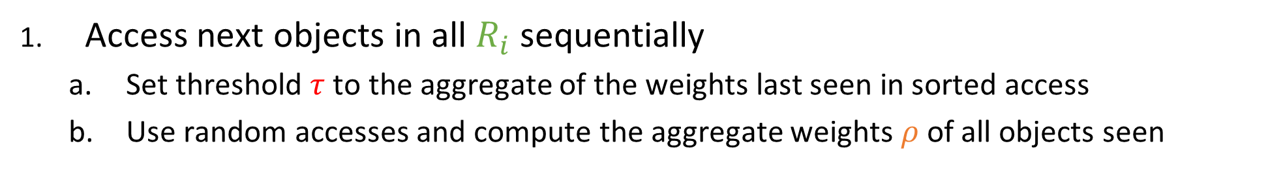
Threshold algorithm [Fagin+ 03]
Access next objects in all $R_{i}$ sequentially
Set threshold $τ$ to the aggregate of the weights last seen in sorted access
Use random accesses and compute the aggregate weights $ρ$of all objects seen
$$R_{1}$$
$$R_{2}$$
$$R_{3}$$
id
$${ w}_{1}$$
$${ w}_{2}$$
$${ w}_{3}$$
id
$${ w}_{1}$$
id
$${ w}_{2}$$
id
$${ w}_{3}$$
$$X_{1}$$
3
$$X_{1}$$
3
$$X_{2}$$
2
$$X_{3}$$
1
$$τ=sum\left(3,2,1\right)= 6$$
$$X_{2}$$
2
$$X_{2}$$
4
$$X_{1}$$
4
$$X_{1}$$
3
$$X_{3}$$
1
$$X_{3}$$
6
$$X_{4}$$
6
$$X_{2}$$
4
$$X_{4}$$
7
$$X_{5}$$
7
$$X_{5}$$
5
$$X_{5}$$
8
$$X_{3}$$
8
$$X_{4}$$
6
[Fagin+ 03] Fagin, Lotem, Naor. Optimal aggregation algorithms for middleware. JCSS 2003. https://doi.org/10.1016/S0022-0000(03)00026-6

Slide 19
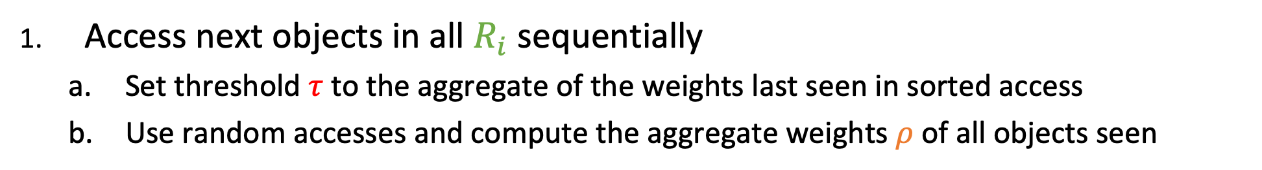
Threshold algorithm [Fagin+ 03]
Access next objects in all $R_{i}$ sequentially
Set threshold $τ$ to the aggregate of the weights last seen in sorted access
Use random accesses and compute the aggregate weights $ρ$of all objects seen
$$R_{1}$$
$$R_{2}$$
$$R_{3}$$
id
$${ w}_{1}$$
$${ w}_{2}$$
$${ w}_{3}$$
id
$${ w}_{1}$$
id
$${ w}_{2}$$
id
$${ w}_{3}$$
$$X_{1}$$
3
4
3
$$X_{1}$$
3
$$X_{2}$$
2
$$X_{3}$$
1
$$τ=sum\left(3,2,1\right)= 6$$
$$X_{2}$$
2
$$X_{2}$$
4
$$X_{1}$$
4
$$X_{1}$$
3
$$X_{3}$$
1
$$X_{3}$$
6
$$X_{4}$$
6
$$X_{2}$$
4
$$X_{4}$$
7
$$X_{5}$$
7
$$X_{5}$$
5
$$X_{5}$$
8
$$X_{3}$$
8
$$X_{4}$$
6
[Fagin+ 03] Fagin, Lotem, Naor. Optimal aggregation algorithms for middleware. JCSS 2003. https://doi.org/10.1016/S0022-0000(03)00026-6

Slide 20
Threshold algorithm [Fagin+ 03]
Access next objects in all $R_{i}$ sequentially
Set threshold $τ$ to the aggregate of the weights last seen in sorted access
Use random accesses and compute the aggregate weights $ρ$of all objects seen
$$R_{1}$$
$$R_{2}$$
$$R_{3}$$
id
$${ w}_{1}$$
$${ w}_{2}$$
$${ w}_{3}$$
id
$${ w}_{1}$$
id
$${ w}_{2}$$
id
$${ w}_{3}$$
$$X_{1}$$
3
4
3
$$X_{1}$$
3
$$X_{2}$$
2
$$X_{3}$$
1
$$τ=sum\left(3,2,1\right)= 6$$
$$X_{2}$$
4
2
4
$$X_{2}$$
4
$$X_{1}$$
4
$$X_{1}$$
3
$$X_{3}$$
1
$$X_{3}$$
6
$$X_{4}$$
6
$$X_{2}$$
4
$$X_{4}$$
7
$$X_{5}$$
7
$$X_{5}$$
5
$$X_{5}$$
8
$$X_{3}$$
8
$$X_{4}$$
6
[Fagin+ 03] Fagin, Lotem, Naor. Optimal aggregation algorithms for middleware. JCSS 2003. https://doi.org/10.1016/S0022-0000(03)00026-6

Slide 21
Threshold algorithm [Fagin+ 03]
Access next objects in all $R_{i}$ sequentially
Set threshold $τ$ to the aggregate of the weights last seen in sorted access
Use random accesses and compute the aggregate weights $ρ$of all objects seen
$$R_{1}$$
$$R_{2}$$
$$R_{3}$$
id
$${ w}_{1}$$
$${ w}_{2}$$
$${ w}_{3}$$
id
$${ w}_{1}$$
id
$${ w}_{2}$$
id
$${ w}_{3}$$
$$X_{1}$$
3
4
3
$$X_{1}$$
3
$$X_{2}$$
2
$$X_{3}$$
1
$$τ=sum\left(3,2,1\right)= 6$$
$$X_{2}$$
4
2
4
$$X_{2}$$
4
$$X_{1}$$
4
$$X_{1}$$
3
$$X_{3}$$
6
8
1
$$X_{3}$$
6
$$X_{4}$$
6
$$X_{2}$$
4
$$X_{4}$$
7
$$X_{5}$$
7
$$X_{5}$$
5
$$X_{5}$$
8
$$X_{3}$$
8
$$X_{4}$$
6
[Fagin+ 03] Fagin, Lotem, Naor. Optimal aggregation algorithms for middleware. JCSS 2003. https://doi.org/10.1016/S0022-0000(03)00026-6

Slide 22
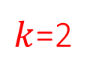

Threshold algorithm [Fagin+ 03]
Access next objects in all $R_{i}$ sequentially
Set threshold $τ$ to the aggregate of the weights last seen in sorted access
Use random accesses and compute the aggregate weights $ρ$of all objects seen
$$R_{1}$$
$$R_{2}$$
$$R_{3}$$
id
$${ w}_{1}$$
$${ w}_{2}$$
$${ w}_{3}$$
sum
id
$${ w}_{1}$$
id
$${ w}_{2}$$
id
$${ w}_{3}$$
$$X_{1}$$
3
4
3
10
$$X_{1}$$
3
$$X_{2}$$
2
$$X_{3}$$
1
$$τ=sum\left(3,2,1\right)= 6$$
$$X_{2}$$
4
2
4
10
$k$=2
$$X_{2}$$
4
$$X_{1}$$
4
$$X_{1}$$
3
$$X_{3}$$
6
8
1
15
$$X_{3}$$
6
$$X_{4}$$
6
$$X_{2}$$
4
$$X_{4}$$
7
$$X_{5}$$
7
$$X_{5}$$
5
focus only on top-$k$ (can purge rest)
$$X_{5}$$
8
$$X_{3}$$
8
$$X_{4}$$
6
[Fagin+ 03] Fagin, Lotem, Naor. Optimal aggregation algorithms for middleware. JCSS 2003. https://doi.org/10.1016/S0022-0000(03)00026-6

Slide 23
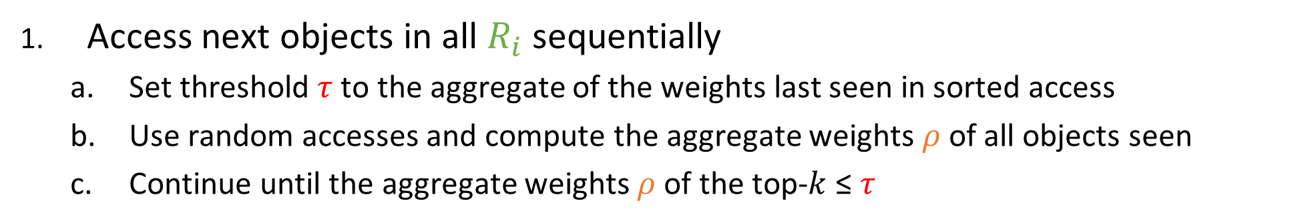
Threshold algorithm [Fagin+ 03]
Access next objects in all $R_{i}$ sequentially
Set threshold $τ$ to the aggregate of the weights last seen in sorted access
Use random accesses and compute the aggregate weights $ρ$of all objects seen
Continue until the aggregate weights $ρ$of the top-$k$ ≤ $τ$
$$R_{1}$$
$$R_{2}$$
$$R_{3}$$
id
$${ w}_{1}$$
$${ w}_{2}$$
$${ w}_{3}$$
sum
id
$${ w}_{1}$$
id
$${ w}_{2}$$
id
$${ w}_{3}$$
$$X_{1}$$
3
4
3
10
$$X_{1}$$
3
$$X_{2}$$
2
$$X_{3}$$
1
$$τ=sum\left(3,2,1\right)= 6$$
$$X_{2}$$
4
2
4
10
$k$=2
$$X_{2}$$
4
$$X_{1}$$
4
$$X_{1}$$
3
$$X_{3}$$
6
8
1
15
$$X_{3}$$
6
$$X_{4}$$
6
$$X_{2}$$
4
$$X_{4}$$
7
$$X_{5}$$
7
$$X_{5}$$
5
focus only on top-$k$ (can purge rest)
$$X_{5}$$
8
$$X_{3}$$
8
$$X_{4}$$
6
$10 \text{≰ }6$: continue: access next objects sequentially
[Fagin+ 03] Fagin, Lotem, Naor. Optimal aggregation algorithms for middleware. JCSS 2003. https://doi.org/10.1016/S0022-0000(03)00026-6

Slide 24
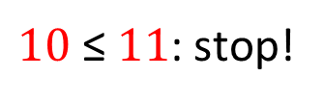

Threshold algorithm [Fagin+ 03]
Access next objects in all $R_{i}$ sequentially
Set threshold $τ$ to the aggregate of the weights last seen in sorted access
Use random accesses and compute the aggregate weights $ρ$of all objects seen
Continue until the aggregate weights $ρ$of the top-$k$ ≤ $τ$
$$R_{1}$$
$$R_{2}$$
$$R_{3}$$
id
$${ w}_{1}$$
$${ w}_{2}$$
$${ w}_{3}$$
sum
id
$${ w}_{1}$$
id
$${ w}_{2}$$
id
$${ w}_{3}$$
$$X_{1}$$
3
4
3
10
$$X_{1}$$
3
$$X_{2}$$
2
$$X_{3}$$
1
$$τ=sum\left(3,2,1\right)= 6$$
$$X_{2}$$
4
2
4
10
$k$=2
$$X_{2}$$
4
$$X_{1}$$
4
$$X_{1}$$
3
$$τ=sum\left(4,4,3\right)=11$$
$$X_{3}$$
6
8
1
15
$$X_{3}$$
6
$$X_{4}$$
6
$$X_{2}$$
4
$$X_{4}$$
7
$$X_{5}$$
7
$$X_{5}$$
5
focus only on top-$k$ (can purge rest)
$$X_{5}$$
8
$$X_{3}$$
8
$$X_{4}$$
6
$10 \text{≤} 11$: stop!
[Fagin+ 03] Fagin, Lotem, Naor. Optimal aggregation algorithms for middleware. JCSS 2003. https://doi.org/10.1016/S0022-0000(03)00026-6

Slide 25
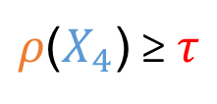





Threshold algorithm [Fagin+ 03]
From the monotonicity property: for any object not seen, the score of the object is bigger than the threshold
Why can we avoid looking at $X_{4}$?
$$4 \text{≤} 7$$
$$4 \text{≤} 6$$
$$\text{3} \text{≤} 6$$
monotonicity
$ρ\text{(}X_{4}\text{)}$ ≥ $τ$
$$R_{1}$$
$$R_{2}$$
$$R_{3}$$
id
$${ w}_{1}$$
$${ w}_{2}$$
$${ w}_{3}$$
sum
id
$${ w}_{1}$$
id
$${ w}_{2}$$
id
$${ w}_{3}$$
$$X_{1}$$
3
4
3
10
$$X_{1}$$
3
$$X_{2}$$
2
$$X_{3}$$
1
$$X_{2}$$
4
2
4
10
$$X_{2}$$
4
$$X_{1}$$
4
$$X_{1}$$
3
$$τ=sum\left(4,4,3\right)=11$$
$$X_{3}$$
6
$$X_{4}$$
6
$$X_{2}$$
4
$$X_{4}$$
7
$$X_{5}$$
7
$$X_{5}$$
5
$$X_{5}$$
8
$$X_{3}$$
8
$$X_{4}$$
6
[Fagin+ 03] Fagin, Lotem, Naor. Optimal aggregation algorithms for middleware. JCSS 2003. https://doi.org/10.1016/S0022-0000(03)00026-6

Slide 26
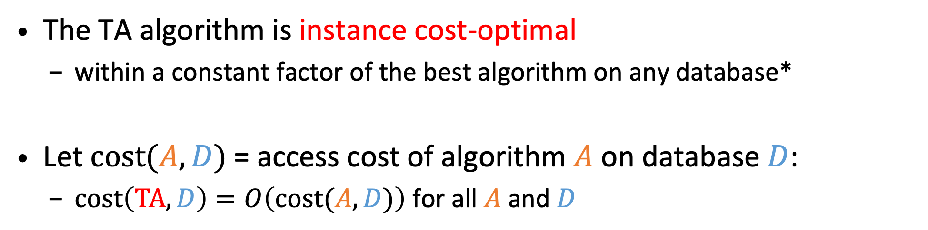
Instance Optimality of Threshold Algorithm (TA)
The TA algorithm is instance cost-optimal
within a constant factor of the best algorithm on any database*
Let $cost(A,D)$ = access cost of algorithm $A$ on database $D$:
$cost\left(TA,D\right)=O\left(cost(A,D)\right)$ for all $A$ and $D$
* Excluding those that make “wild guesses” = random access to object without first seeing it with sorted access
[Fagin+ 03] Fagin, Lotem, Naor. Optimal aggregation algorithms for middleware. JCSS 2003. https://doi.org/10.1016/S0022-0000(03)00026-6

Slide 28












Goal: Generalize TA setup to arbitrary join patterns
natural join
Same cost model: measuring access cost
to simplify, we ignore random accesses
select A₁, A₂, A₃, A₄,
sum(w₁,w₂,w₃) as weight
from R₁, R₂, R₃
where R₁.A₂=R₂.A₂
and R₂.A₃=R₃.A₃
order by weight
limit 1
many-to-many relationships
no unique identifier per join result
arbitrary join conditions possible
$$R_{1}$$
$$R_{2}$$
$$R_{3}$$
$${ A}_{1}$$
$${ A}_{2}$$
$${ w}_{1}$$
$${ A}_{2}$$
$${ A}_{3}$$
$${ w}_{2}$$
$${ A}_{3}$$
$${ A}_{4}$$
$${ w}_{3}$$
a
b
1
d
c
1
c
d
1
c
b
4
b
c
2
a
a
2
b
d
5
b
a
3
a
d
3

Slide 30
J* Algorithm [Natsev+ 01]
Idea: A* search on the Cartesian product to find top-𝑘 join results
Keep Priority Queue (PQ) of partial results
Pop partial result with smallest lower bound (based on what has been seen) and access lists to extend it
left to right (showing row id's)
$$R_{1}$$
$$R_{2}$$
$$R_{3}$$
Partial Solution
Next Tuple
Lower bound
$${ A}_{1}$$
$${ A}_{2}$$
$${ w}_{1}$$
$${ A}_{2}$$
$${ A}_{3}$$
$${ w}_{2}$$
$${ A}_{3}$$
$${ A}_{4}$$
$${ w}_{3}$$
()
R₁:1
0+0+0=0
1
a
b
1
1
d
c
1
1
c
d
1
2
c
b
4
2
b
c
2
2
a
a
2
3
b
d
5
3
b
a
3
3
a
d
3
[Natsev+ 01] Natsev, Chang, Smith, Li, Vitter. Supporting incremental join queries on ranked inputs. VLDB 2001. https://doi.org/doi/10.5555/645927.672365
Notes:
central is a PQ of partial solutions to expand;
expand from left to right

Slide 31
J* Algorithm [Natsev+ 01]
Idea: A* search on the Cartesian product to find top-𝑘 join results
Keep Priority Queue (PQ) of partial results
Pop partial result with smallest lower bound (based on what has been seen) and access lists to extend it
If still incomplete, push back 2 new ones: one “longer”, one “deeper”
left to right (showing row id's)
$$R_{1}$$
$$R_{2}$$
$$R_{3}$$
Partial Solution
Next Tuple
Lower bound
$${ A}_{1}$$
$${ A}_{2}$$
$${ w}_{1}$$
$${ A}_{2}$$
$${ A}_{3}$$
$${ w}_{2}$$
$${ A}_{3}$$
$${ A}_{4}$$
$${ w}_{3}$$
(1)
R₂:1
1+0+0=1
1
a
b
1
1
d
c
1
1
c
d
1
()
R₁:2
1+0+0=1
c
b
4
b
c
2
a
a
2
2
2
2
3
b
d
5
3
b
a
3
3
a
d
3
[Natsev+ 01] Natsev, Chang, Smith, Li, Vitter. Supporting incremental join queries on ranked inputs. VLDB 2001. https://doi.org/doi/10.5555/645927.672365

Slide 32
J* Algorithm [Natsev+ 01]
Idea: A* search on the Cartesian product to find top-𝑘 join results
Keep Priority Queue (PQ) of partial results
Pop partial result with smallest lower bound (based on what has been seen) and access lists to extend it
If still incomplete, push back 2 new ones: one “longer”, one “deeper”
left to right (showing row id's)
$$R_{1}$$
$$R_{2}$$
$$R_{3}$$
Partial Solution
Next Tuple
Lower bound
$${ A}_{1}$$
$${ A}_{2}$$
$${ w}_{1}$$
$${ A}_{2}$$
$${ A}_{3}$$
$${ w}_{2}$$
$${ A}_{3}$$
$${ A}_{4}$$
$${ w}_{3}$$
(1)
R₂:1
1+0+0=1
1
a
b
1
1
d
c
1
1
c
d
1
()
R₁:2
1+0+0=1
c
b
4
b
c
2
a
a
2
2
2
2
3
b
d
5
3
b
a
3
3
a
d
3
[Natsev+ 01] Natsev, Chang, Smith, Li, Vitter. Supporting incremental join queries on ranked inputs. VLDB 2001. https://doi.org/doi/10.5555/645927.672365

Slide 33
J* Algorithm [Natsev+ 01]
Idea: A* search on the Cartesian product to find top-𝑘 join results
Keep Priority Queue (PQ) of partial results
Pop partial result with smallest lower bound (based on what has been seen) and access lists to extend it
If still incomplete, push back 2 new ones: one “longer”, one “deeper”
invalid join condition, thus discard partial solution
left to right (showing row id's)
$$R_{1}$$
$$R_{2}$$
$$R_{3}$$
Partial Solution
Next Tuple
Lower bound
$${ A}_{1}$$
$${ A}_{2}$$
$${ w}_{1}$$
$${ A}_{2}$$
$${ A}_{3}$$
$${ w}_{2}$$
$${ A}_{3}$$
$${ A}_{4}$$
$${ w}_{3}$$
(1)
R₂:2
1+1+0=2
1
a
b
1
1
d
c
1
1
c
d
1
()
R₁:2
1+0+0=1
c
b
4
b
c
2
a
a
2
2
2
2
3
b
d
5
3
b
a
3
3
a
d
3
[Natsev+ 01] Natsev, Chang, Smith, Li, Vitter. Supporting incremental join queries on ranked inputs. VLDB 2001. https://doi.org/doi/10.5555/645927.672365

Slide 34
J* Algorithm [Natsev+ 01]
Idea: A* search on the Cartesian product to find top-𝑘 join results
Keep Priority Queue (PQ) of partial results
Pop partial result with smallest lower bound (based on what has been seen) and access lists to extend it
If still incomplete, push back 2 new ones: one “longer”, one “deeper”
left to right (showing row id's)
$$R_{1}$$
$$R_{2}$$
$$R_{3}$$
Partial Solution
Next Tuple
Lower bound
$${ A}_{1}$$
$${ A}_{2}$$
$${ w}_{1}$$
$${ A}_{2}$$
$${ A}_{3}$$
$${ w}_{2}$$
$${ A}_{3}$$
$${ A}_{4}$$
$${ w}_{3}$$
(1)
R₂:2
1+1+0=2
1
a
b
1
1
d
c
1
1
c
d
1
()
R₁:2
1+0+0=1
c
b
4
b
c
2
a
a
2
2
2
2
3
b
d
5
3
b
a
3
3
a
d
3
[Natsev+ 01] Natsev, Chang, Smith, Li, Vitter. Supporting incremental join queries on ranked inputs. VLDB 2001. https://doi.org/doi/10.5555/645927.672365

Slide 35
J* Algorithm [Natsev+ 01]
Idea: A* search on the Cartesian product to find top-𝑘 join results
Keep Priority Queue (PQ) of partial results
Pop partial result with smallest lower bound (based on what has been seen) and access lists to extend it
If still incomplete, push back 2 new ones: one “longer”, one “deeper”
left to right (showing row id's)
$$R_{1}$$
$$R_{2}$$
$$R_{3}$$
Partial Solution
Next Tuple
Lower bound
$${ A}_{1}$$
$${ A}_{2}$$
$${ w}_{1}$$
$${ A}_{2}$$
$${ A}_{3}$$
$${ w}_{2}$$
$${ A}_{3}$$
$${ A}_{4}$$
$${ w}_{3}$$
(1)
R₂:2
1+1+0=2
1
a
b
1
1
d
c
1
1
c
d
1
(2)
R₂:1
4+0+0=4
c
b
4
b
c
2
a
a
2
()
R₁:3
4+0+0=4
2
2
2
3
b
d
5
3
b
a
3
3
a
d
3
[Natsev+ 01] Natsev, Chang, Smith, Li, Vitter. Supporting incremental join queries on ranked inputs. VLDB 2001. https://doi.org/doi/10.5555/645927.672365

Slide 36
J* Algorithm [Natsev+ 01]
Idea: A* search on the Cartesian product to find top-𝑘 join results
Keep Priority Queue (PQ) of partial results
Pop partial result with smallest lower bound (based on what has been seen) and access lists to extend it
If still incomplete, push back 2 new ones: one “longer”, one “deeper”
left to right (showing row id's)
$$R_{1}$$
$$R_{2}$$
$$R_{3}$$
Partial Solution
Next Tuple
Lower bound
$${ A}_{1}$$
$${ A}_{2}$$
$${ w}_{1}$$
$${ A}_{2}$$
$${ A}_{3}$$
$${ w}_{2}$$
$${ A}_{3}$$
$${ A}_{4}$$
$${ w}_{3}$$
(1)
R₂:2
1+1+0=2
1
a
b
1
1
d
c
1
1
c
d
1
(2)
R₂:1
4+0+0=4
c
b
4
b
c
2
a
a
2
()
R₁:3
4+0+0=4
2
2
2
3
b
d
5
3
b
a
3
3
a
d
3
[Natsev+ 01] Natsev, Chang, Smith, Li, Vitter. Supporting incremental join queries on ranked inputs. VLDB 2001. https://doi.org/doi/10.5555/645927.672365

Slide 37
J* Algorithm [Natsev+ 01]
Idea: A* search on the Cartesian product to find top-𝑘 join results
Keep Priority Queue (PQ) of partial results
Pop partial result with smallest lower bound (based on what has been seen) and access lists to extend it
If still incomplete, push back 2 new ones: one “longer”, one “deeper”
left to right (showing row id's)
$$R_{1}$$
$$R_{2}$$
$$R_{3}$$
Partial Solution
Next Tuple
Lower bound
$${ A}_{1}$$
$${ A}_{2}$$
$${ w}_{1}$$
$${ A}_{2}$$
$${ A}_{3}$$
$${ w}_{2}$$
$${ A}_{3}$$
$${ A}_{4}$$
$${ w}_{3}$$
(1,2)
R₃:1
1+2+0=3
1
a
b
1
1
d
c
1
1
c
d
1
(1)
R₂:3
1+2+0=3
c
b
4
b
c
2
a
a
2
(2)
R₂:1
4+0+0=4
2
2
2
()
R₁:3
4+0+0=4
3
b
d
5
3
b
a
3
3
a
d
3
[Natsev+ 01] Natsev, Chang, Smith, Li, Vitter. Supporting incremental join queries on ranked inputs. VLDB 2001. https://doi.org/doi/10.5555/645927.672365

Slide 38
J* Algorithm [Natsev+ 01]
Idea: A* search on the Cartesian product to find top-𝑘 join results
Keep Priority Queue (PQ) of partial results
Pop partial result with smallest lower bound (based on what has been seen) and access lists to extend it
If still incomplete, push back 2 new ones: one “longer”, one “deeper”
left to right (showing row id's)
$$R_{1}$$
$$R_{2}$$
$$R_{3}$$
Partial Solution
Next Tuple
Lower bound
$${ A}_{1}$$
$${ A}_{2}$$
$${ w}_{1}$$
$${ A}_{2}$$
$${ A}_{3}$$
$${ w}_{2}$$
$${ A}_{3}$$
$${ A}_{4}$$
$${ w}_{3}$$
(1,2)
R₃:1
1+2+0=3
1
a
b
1
1
d
c
1
1
c
d
1
(1)
R₂:3
1+2+0=3
c
b
4
b
c
2
a
a
2
(2)
R₂:1
4+0+0=4
2
2
2
()
R₁:3
4+0+0=4
3
b
d
5
3
b
a
3
3
a
d
3
[Natsev+ 01] Natsev, Chang, Smith, Li, Vitter. Supporting incremental join queries on ranked inputs. VLDB 2001. https://doi.org/doi/10.5555/645927.672365

Slide 39
J* Algorithm [Natsev+ 01]
Idea: A* search on the Cartesian product to find top-𝑘 join results
Keep Priority Queue (PQ) of partial results
Pop partial result with smallest lower bound (based on what has been seen) and access lists to extend it
If still incomplete, push back 2 new ones: one “longer”, one “deeper”
left to right (showing row id's)
$$R_{1}$$
$$R_{2}$$
$$R_{3}$$
Partial Solution
Next Tuple
Lower bound
Lower bound
$${ A}_{1}$$
$${ A}_{2}$$
$${ w}_{1}$$
$${ A}_{2}$$
$${ A}_{3}$$
$${ w}_{2}$$
$${ A}_{3}$$
$${ A}_{4}$$
$${ w}_{3}$$
(1,2,1)
1+2+1=4
1
a
b
1
1
d
c
1
1
c
d
1
(1,2)
R₃:2
1+2+1=4
c
b
4
b
c
2
a
a
2
(1)
R₂:3
1+2+0=3
2
2
2
(2)
R₂:1
4+0+0=4
3
b
d
5
3
b
a
3
3
a
d
3
()
R₁:3
4+0+0=4
[Natsev+ 01] Natsev, Chang, Smith, Li, Vitter. Supporting incremental join queries on ranked inputs. VLDB 2001. https://doi.org/doi/10.5555/645927.672365

Slide 40
J* Algorithm [Natsev+ 01]
Idea: A* search on the Cartesian product to find top-𝑘 join results
Keep Priority Queue (PQ) of partial results
Pop partial result with smallest lower bound (based on what has been seen) and access lists to extend it
If still incomplete, push back 2 new ones: one “longer”, one “deeper”
left to right (showing row id's)
$$R_{1}$$
$$R_{2}$$
$$R_{3}$$
Partial Solution
Next Tuple
Lower bound
Lower bound
$${ A}_{1}$$
$${ A}_{2}$$
$${ w}_{1}$$
$${ A}_{2}$$
$${ A}_{3}$$
$${ w}_{2}$$
$${ A}_{3}$$
$${ A}_{4}$$
$${ w}_{3}$$
(1,2,1)
1+2+1=4
1
a
b
1
1
d
c
1
1
c
d
1
(1,2)
R₃:2
1+2+1=4
c
b
4
b
c
2
a
a
2
(1,3)
R₃:1
1+3+0=4
2
2
2
(2)
R₂:1
4+0+0=4
3
b
d
5
3
b
a
3
3
a
d
3
()
R₁:3
4+0+0=4
[Natsev+ 01] Natsev, Chang, Smith, Li, Vitter. Supporting incremental join queries on ranked inputs. VLDB 2001. https://doi.org/doi/10.5555/645927.672365

Slide 41
J* Algorithm [Natsev+ 01]
Idea: A* search on the Cartesian product to find top-𝑘 join results
Keep Priority Queue (PQ) of partial results
Pop partial result with smallest lower bound (based on what has been seen) and access lists to extend it
If still incomplete, push back 2 new ones: one “longer”, one “deeper”
left to right (showing row id's)
$$R_{1}$$
$$R_{2}$$
$$R_{3}$$
Partial Solution
Next Tuple
Lower bound
Lower bound
$${ A}_{1}$$
$${ A}_{2}$$
$${ w}_{1}$$
$${ A}_{2}$$
$${ A}_{3}$$
$${ w}_{2}$$
$${ A}_{3}$$
$${ A}_{4}$$
$${ w}_{3}$$
(1,2,1)
1+2+1=4
top-1
1
a
b
1
1
d
c
1
1
c
d
1
(1,2)
R₃:2
1+2+1=4
c
b
4
b
c
2
a
a
2
(1,3)
R₃:1
1+3+0=4
2
2
2
(2)
R₂:1
4+0+0=4
3
b
d
5
3
b
a
3
3
a
d
3
()
R₁:3
4+0+0=4
[Natsev+ 01] Natsev, Chang, Smith, Li, Vitter. Supporting incremental join queries on ranked inputs. VLDB 2001. https://doi.org/doi/10.5555/645927.672365

Slide 42
J* w/ iterative deepening [Natsev+ 01] & Rank Join [Ilyas+ 04]
To guarantee instance optimality for J*, go deeper only after producing all results (iterative deepening) [Natsev+ 01]
Rank-Join [Ilyas+ 04]: Instead of A* type of search use a threshold value similarly to TA. Also instance-optimal in terms of accesses
Many variants and much follow-up work (different join strategies, heuristics to prioritize relations, etc.)
$$R_{1}$$
$$R_{2}$$
$$R_{3}$$
$${ A}_{1}$$
$${ A}_{2}$$
$${ w}_{1}$$
$${ A}_{2}$$
$${ A}_{3}$$
$${ w}_{2}$$
$${ A}_{3}$$
$${ A}_{4}$$
$${ w}_{3}$$
Depth=1 : 0 results
1
a
b
1
1
d
c
1
1
c
d
1
Depth=2 : 2 results
2
c
b
4
2
b
c
2
2
a
a
2
Depth=1 : 7 results
3
b
d
5
3
b
a
3
3
a
d
3
[Ilyas+ 04] Ilyas, Aref, Elmagarmid. Supporting top-k join queries in relational databases. VLDBJ 2004. https://doi.org/10.1007/s00778-004-0128-2
[Natsev+ 01] Natsev, Chang, Smith, Li, Vitter. Supporting incremental join queries on ranked inputs. VLDB 2001. https://doi.org/doi/10.5555/645927.672365

Slide 43
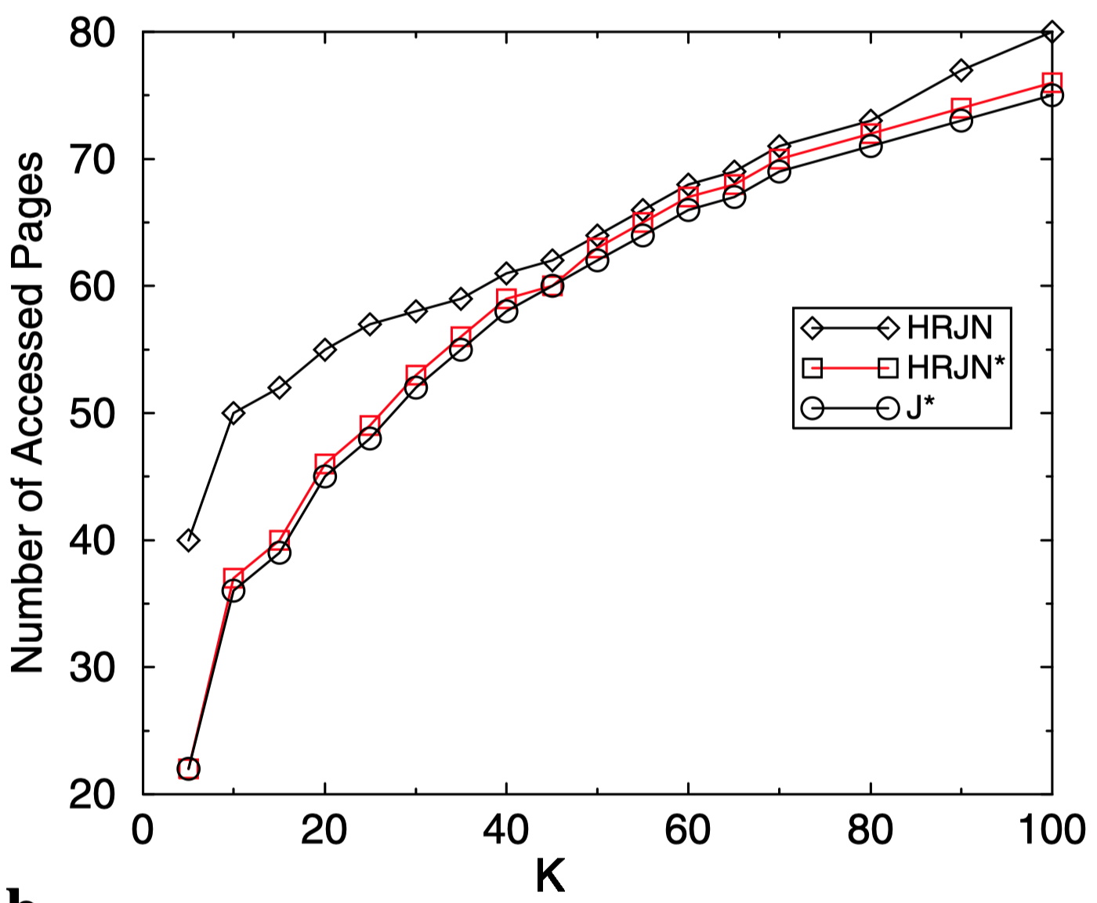
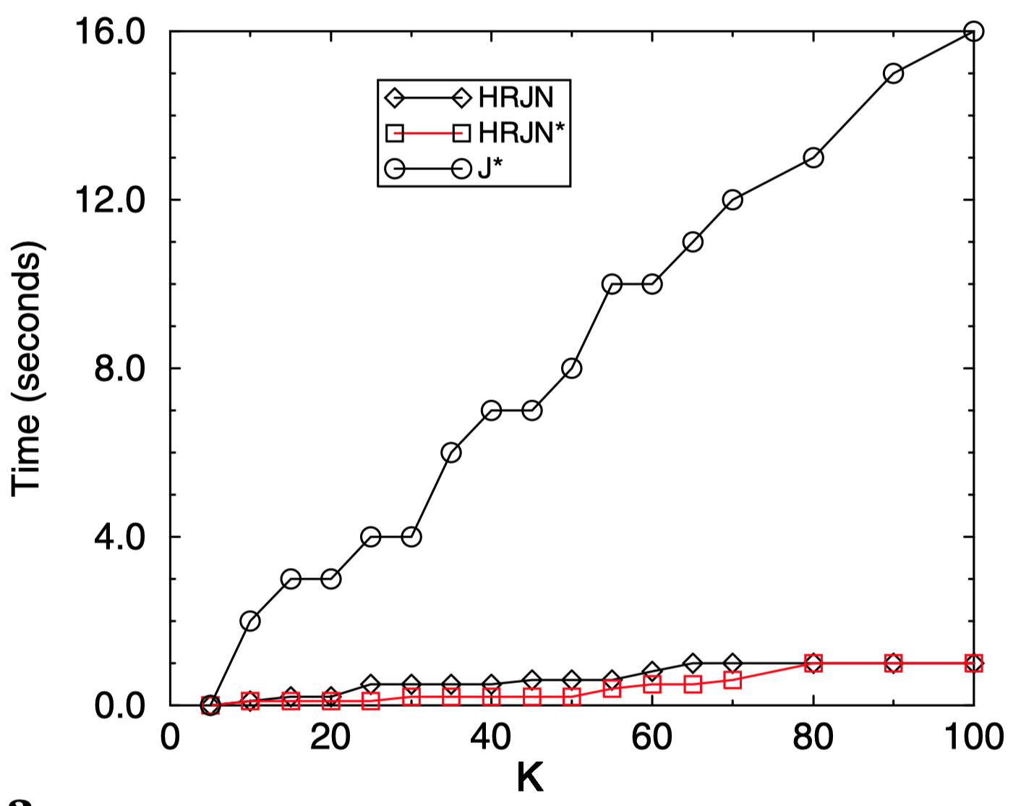
Figures from [Ilyas+ 04]
Similar access cost, but different times in practice.
Is # of access cost thus a reasonable cost model?
[Ilyas+ 04] Ilyas, Aref, Elmagarmid. Supporting top-k join queries in relational databases. VLDBJ 2004. https://doi.org/10.1007/s00778-004-0128-2

Slide 45













Middleware cost model vs. in-database join computations
$$R_{1}$$
$$R_{2}$$
$$R_{3}$$
$${ A}_{1}$$
$${ A}_{2}$$
$${ w}_{1}$$
$${ A}_{2}$$
$${ A}_{3}$$
$${ w}_{2}$$
$${ A}_{3}$$
$${ A}_{4}$$
$${ w}_{3}$$
1
1
1
1
1
10
0
0
0
2
1
2
1
2
20
1
1
100
…
…
...
…
…
...
…
…
...
9
1
9
1
9
90
8
8
800
0
0
10
0
0
100
9
9
900
$$n$$
[Ilyas+ 04] Ilyas, Aref, Elmagarmid. Supporting top-k join queries in relational databases. VLDBJ 2004. https://doi.org/10.1007/s00778-004-0128-2
[Natsev+ 01] Natsev, Chang, Smith, Li, Vitter. Supporting incremental join queries on ranked inputs. VLDB 2001. https://doi.org/doi/10.5555/645927.672365

Slide 46

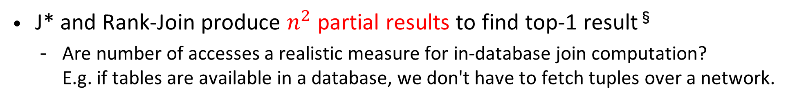


Middleware cost model vs. in-database join computations
†
J* and Rank-Join produce $n^{2}$ partial results to find top-1 result§
Are number of accesses a realistic measure for in-database join computation? E.g. if tables are available in a database, we don't have to fetch tuples over a network.
⇒ How to most effectively push sorting through joins?
RAM cost model
$$R_{1}$$
$$R_{2}$$
$$R_{3}$$
Middleware cost model
$${ A}_{1}$$
$${ A}_{2}$$
$${ w}_{1}$$
$${ A}_{2}$$
$${ A}_{3}$$
$${ w}_{2}$$
$${ A}_{3}$$
$${ A}_{4}$$
$${ w}_{3}$$
In-memory join comp.
1
1
1
1
1
10
0
0
0
Minimize access depth
2
1
2
1
2
20
1
1
100
quadratic cost
linear cost
…
…
...
…
…
...
…
…
...
in-memory processing: join time matters
Information retrieval: latency/ access cost matters
9
1
9
1
9
90
8
8
800
0
0
10
0
0
100
9
9
900
$$n$$
§ Assuming sorted accesses only. If random accesses allowed, another slightly more complicated example shows the same issue.
[Ilyas+ 04] Ilyas, Aref, Elmagarmid. Supporting top-k join queries in relational databases. VLDBJ 2004. https://doi.org/10.1007/s00778-004-0128-2
[Natsev+ 01] Natsev, Chang, Smith, Li, Vitter. Supporting incremental join queries on ranked inputs. VLDB 2001. https://doi.org/doi/10.5555/645927.672365

Slide 47
Middleware cost model vs. in-database join computations
†
J* and Rank-Join produce $n^{2}$ partial results to find top-1 result§
Are number of accesses a realistic measure for in-database join computation? E.g. if tables are available in a database, we don't have to fetch tuples over a network.
⇒ How to most effectively push sorting through joins?
A natural question:
What can one do under a RAM cost model for general conjunctive queries?
RAM cost model
$$R_{1}$$
$$R_{2}$$
$$R_{3}$$
Middleware cost model
$${ A}_{1}$$
$${ A}_{2}$$
$${ w}_{1}$$
$${ A}_{2}$$
$${ A}_{3}$$
$${ w}_{2}$$
$${ A}_{3}$$
$${ A}_{4}$$
$${ w}_{3}$$
In-memory join comp.
1
1
1
1
1
10
0
0
0
Minimize access depth
2
1
2
1
2
20
1
1
100
quadratic cost
linear cost
…
…
...
…
…
...
…
…
...
in-memory processing: join time matters
Information retrieval: latency/ access cost matters
9
1
9
1
9
90
8
8
800
0
0
10
0
0
100
9
9
900
$$n$$
§ Assuming sorted accesses only. If random accesses allowed, another slightly more complicated example shows the same issue.
[Ilyas+ 04] Ilyas, Aref, Elmagarmid. Supporting top-k join queries in relational databases. VLDBJ 2004. https://doi.org/10.1007/s00778-004-0128-2
[Natsev+ 01] Natsev, Chang, Smith, Li, Vitter. Supporting incremental join queries on ranked inputs. VLDB 2001. https://doi.org/doi/10.5555/645927.672365

Slide 48
An excerpt of rich literature, once access determines cost ...
What if the ranking function is the distance from a desired (high-dimensional) point?
[Bruno+ TODS’02]: Rewrite as a range query and restart if #results < k
What if we are allowed to pre-compute data structures and learn the ranking function at query time?
[Tsaparas+ ICDE’03]: Find linear ranking functions that act as “separators” (i.e., they change the top-k set)
[Chang+ SIGMOD’00]: Construct convex hulls for linear ranking functions
[Hristidis+ SIGMOD’01, Das+ VLDB’06]: Materialize ranked views for some selected ranking functions
What if the ranking function is non-monotone?
[Zhang+ SIGMOD’06]: Use continuous function optimization methods
What if the query model is different?
"SMART" [Wu+ VLDB’10]: Query contains disjunctions, partial results allowed to be returned
...
Please see dedicated tutorials and surveys on top-k
Bruno, Chaudhuri, Gravano. Top-k selection queries over relational databases: Mapping strategies and performance evaluation. TODS 2002. https://doi.org/10.1145/568518.568519
Tsaparas, Palpanas, Kotidis, Koudas, Srivastava. Ranked join indices. ICDE 2003. https://doi.org/10.1109/ICDE.2003.1260799
Chang, Bergman, Castelli, Li, Lo, Smith. The onion technique: Indexing for linear optimization queries. SIGMOD 2000. https://doi.org/10.1145/342009.335433
Hristidis, Koudas, Papakonstantinou. PREFER: A system for the efficient execution of multi-parametric ranked queries. SIGMOD 2001. https://doi.org/10.1145/376284.375690
Das, Gunopulos, Koudas, Tsirogiannis. Answering top-k queries using views. VLDB 2006. http://www.vldb.org/conf/2006/p451-das.pdf
Zhang, Hwang, Chang, Wang, Lang, Chang. Boolean + ranking: querying a database by k-constrained optimization. SIGMOD 2006. https://doi.org/10.1145/1142473.1142515
Wu, Berti-Equille, Marian, Procopiuc, Srivastava. Processing top-k join queries. VLDB 2010. https://doi.org/10.14778/1920841.1920951

